Slide 1



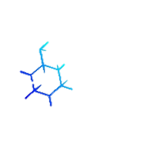
Detection Of Laylat Al-Qadr In Ramadan Using Iqra' Algorithm Based On Unique Anomaly As Luxlier Data Detection To Proving The Truth Signs Of Islam
The 13th International Conference on Green Technology (ICGT-XIII 2023)
“Strengthening the Impact of STEM world (Science, Technology, Engineering, and Mathematics) for a Sustainable Future”
Our Teams:
Imam Cholissodin, S.Si., M.Kom KH. Achmad Shampton, S.HI, M.Ag Arief Andy Soebroto, S.T., M.Kom.
Email: imamcs@ub.ac.id
Lecturer of Faculty Of Computer Science (a.k.a FILKOM) UB
Malang, October 17-18 2023

Slide 2




Contents
Introduction
Literature review
Data Science of Ramadan and Deep Mining of Laylat al-Qadr
Dataset Weather as Features LQ based Qur’an and Hadist
Research (Novelty)
Result & Discussion
Conclusions & Future Work
ICGT-XIII 2023, Malang
By: Imam Cholissodin | Faculty Of Computer Science (a.k.a FILKOM), UB

Slide 3

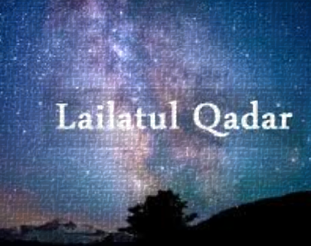
Introduction
Interconnected with features in the Qur'an and Hadith regarding the importance of the role, contribution and synergy between science and technology supported by community organizations through NU community (etc), Campus and Government.
There are numerous secrets in the form of interesting puzzles in the “Signs of Truth” package contained in the Qur'an, one of which is the riddle of when Laylat al-Qadr (LQ) occurred in QS Al Qadr:1-5.
Therefore, there is a necessity to use:
Inspired
Qur’an
Hadith
Supervised by “Ulama Aswaja” and Community
Hybrid AI Engine
Contribution, iQra’ algorithm to LQ Identification
This puzzle is actually easy and can be solved using applied technology such as scientific Data Science, “let the data do the talking” the sign truth of Islam. ☺
Fact of Lailatul Qadar
ICGT-XIII 2023, Malang
By: Imam Cholissodin | Faculty Of Computer Science (a.k.a FILKOM), UB
Notes:
Source:
[1] https://bioeng.kaist.ac.kr/index.php?mid=bio_02_02&document_srl=6964 20/8/2021

Slide 4
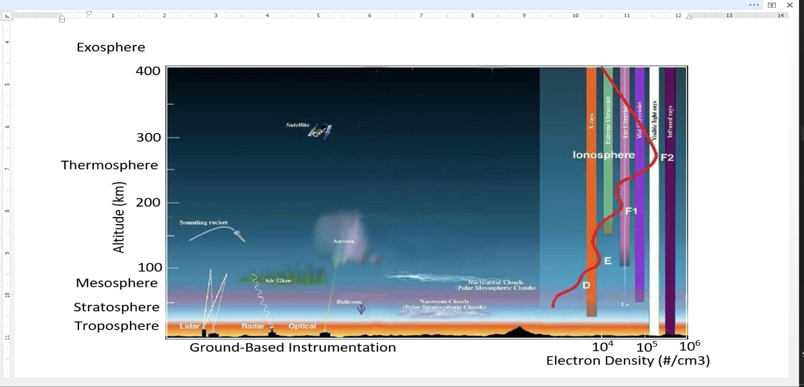
Literature | Data Science of Ramadan
Laylat al-Qadr is a night (bright-night) which is considered unique because it only occurs once a year and only occurs in the month of Ramadan.
Data Science of Ramadan is an approach to how our Science recognizes the Signs of Truth from Allah SWT using science from advanced technology to reveal the meaning or identification of the Signs of Truth of an event in the month of Ramadan, one of which is related to performing Deep Mining computation of Laylat al-Qadr.
When viewed from the air temperature feature, the air temperature is "not cold and not hot”, which as the reference from the Hadith of Rasulullah SAW is in the atmospheric layer closest to the earth.
Earth's Atmospheric Layers NASA [5]
ICGT-XIII 2023, Malang
By: Imam Cholissodin | Faculty Of Computer Science (a.k.a FILKOM), UB
Notes:
[1] https://home.cancerresearch/the-human-genome-project-is-declared-complete/ 20/8/2021

Slide 5

Literature | Qur’an and Hadith
Allah SWT gives clear and obvious signs, especially on the occurrence of LQ.
Regarding the LQ features, in the Hadith [Sahih Al Bukhari Vol. 3 Book of Laylatul Qadr Hadith 2017; Sahih Al Bukhari Vol. 1 Book of Faith Hadith 49; Sahih Muslim Vol. 2 Book of Fasting Hadith 2364; Sunan Al Tirmidhi Book of Fasting Hadith 794; Sahih Al Bukhari Vol. 3 Book of I'tikaaf Hadith 2020; Sahih Muslim Vol. 2 Book of Fasting Hadith 2621; Sahih Al Bukhari Vol. 3 Book of Laylatul Qadr Hadith 2015] it has been mentioned that Muslims have been shown the signs of its occurrence and presence [10], which include:
On that day, the sun does not shine too hot with very cool weather, as the hadith narrated by Imam Muslim.
At night, the sky looks clean without the sight of the slightest cloud, the atmosphere is calm and quiet, not cold and not hot. This is based on a narration by Imam Ahmad.
In Mu'jam at-Tabari al-Kabir it is stated that the Prophet SAW said: “On the night of Laylat al-Qadr, the sky is clean, the air is not cold or hot, the sky is not cloudy, there is no rain, the stars do not appear and during the day the sun does not shine so hot”.
Integrated Al Engine, and High Technology to Build Smart Islamic Apps
ICGT-XIII 2023, Malang
By: Imam Cholissodin | Faculty Of Computer Science (a.k.a FILKOM), UB
Notes:
[1] https://home.cancerresearch/the-human-genome-project-is-declared-complete/ 20/8/2021

Slide 6
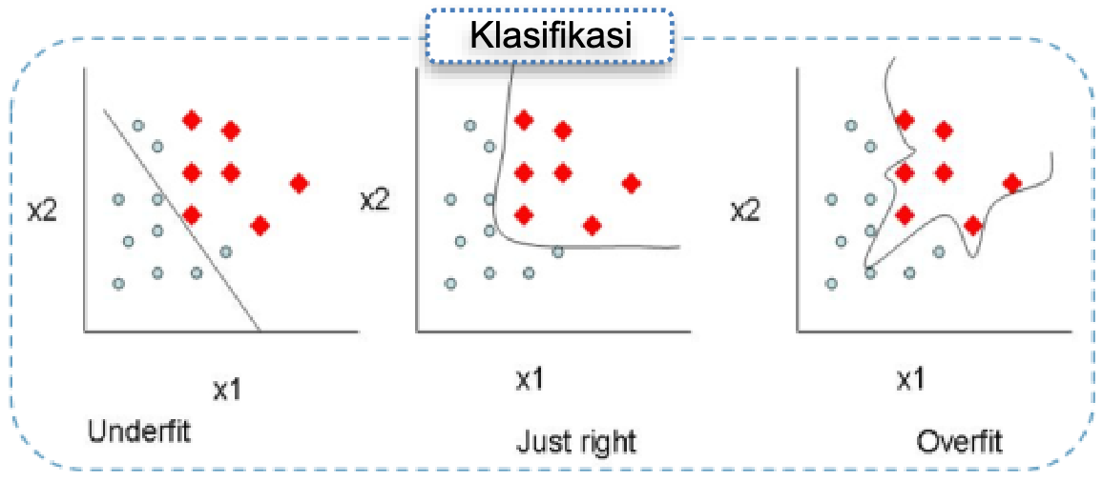
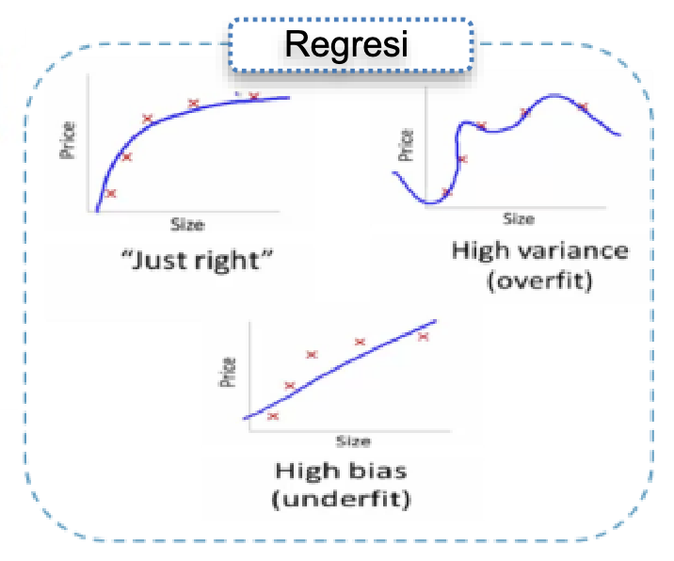
Literature | Prediction vs Others
Comparison, Prediction is general type of Classification (discrete with specific label class / supervised learning, get best boundary decision, metrics by accuracy, precision, recall, f1, roc, etc).
In our study we propose by combine semi-prediction & semi-unsupervised learning to Luxier identification.
Classification
Regression
ICGT-XIII 2023, Malang
By: Imam Cholissodin | Faculty Of Computer Science (a.k.a FILKOM), UB
Notes:
[1] https://phcogj.com/article/1001 20/8/2021
[2] https://bioeng.kaist.ac.kr/index.php?mid=bio_02_02&document_srl=6964
[3] https://tranquilitylabs.com/blogs/news/natural-nootropics-vs-synthetic-smart-drugs-a-comparison

Slide 7

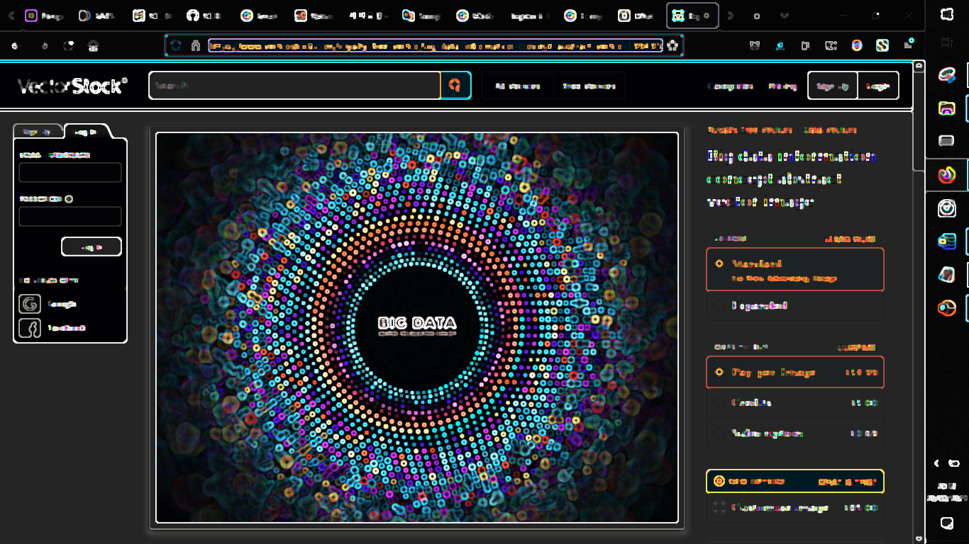

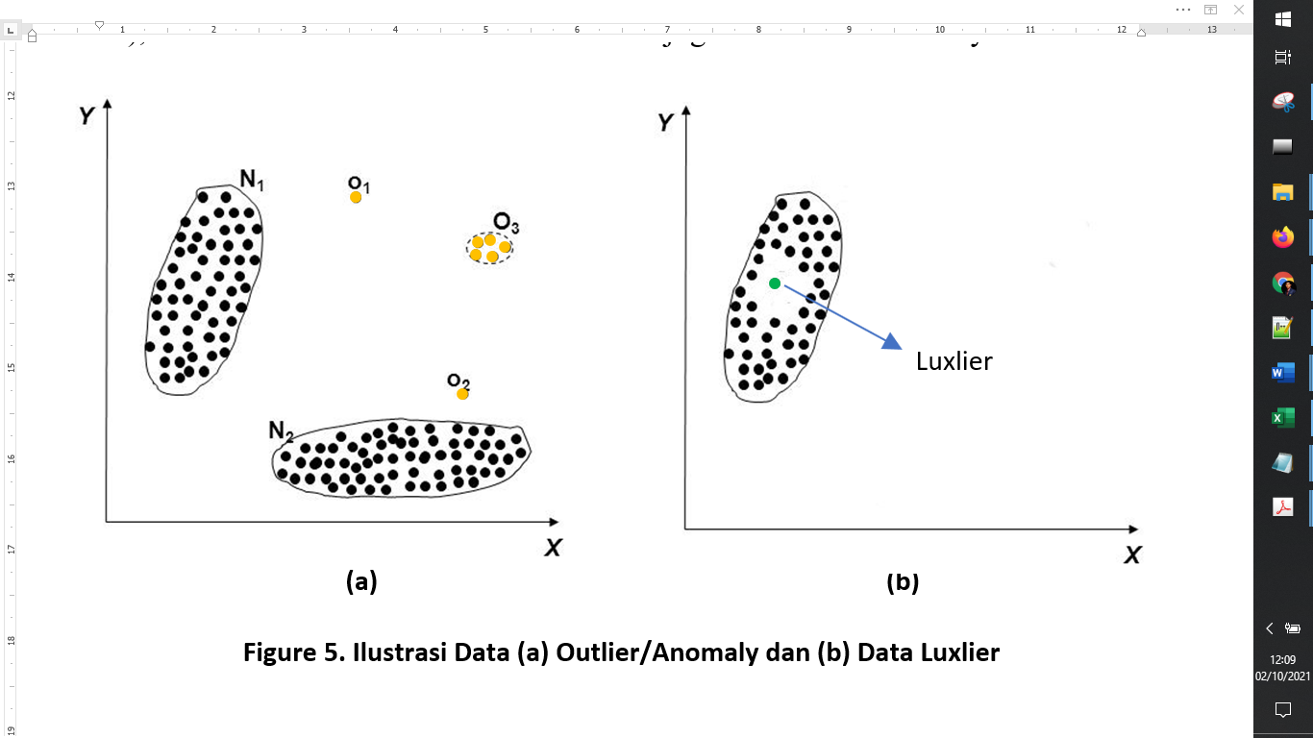

Data Anomaly and Luxlier
Luxlier detection is a technique that we developed in this research as a new contribution to science, i.e., to detect a very unique valid data (∃! which means one and only one), very special, very distinctive, very particular and luxurious.
So Luxlier data, It is not outliers (like anomaly data)
Dataset
ICGT-XIII 2023, Malang
By: Imam Cholissodin | Faculty Of Computer Science (a.k.a FILKOM), UB
Notes:
Source:
[1] https://www.resultseng.com/big-data
[2] https://www.vectorstock.com/royalty-free-vector/big-data-information-concept-abstract-vector-19949362
[3] https://blogs.sap.com/2017/04/02/big-data-hype-or-a-new-revolution/
[4] https://www.varonis.com/blog/docker-vs-kubernetes/

Slide 8
Research | Dataset
Time Difference between Jakarta and Cities in the World
The Weather Dataset used in this study was taken by utilizing the Application Programming Interface (API), i.e., api.openweathermap.org which used temperature, humidity, and others values recorded from the list of 21 cities shown in Table 1.
The considerations used in determining these cities are related to the time difference for the city of Jakarta, where the data was taken once a day. The data collection was between 20.00 – 20.30 WIB.
Table 1. Time Difference between Jakarta and Cities in the World
No | City Name | Time difference (hours)
1 | Jakarta | 0
2 | Los Angeles | −14
3 | Chicago | −12
4 | New York City | −11
5 | Toronto | −11
6 | São Paulo | −10
7 | Lagos | −6
8 | London | −6
9 | Johannesburg | −5
10 | Kairo | −5
11 | Paris | −5
12 | Zurich | −5
13 | Istanbul | −4
14 | Moskwa | −4
15 | Dubai | −3
16 | Mumbai | −1.5
17 | Hong Kong | +1
18 | Shanghai | +1
19 | Singapura | +1
20 | Tokyo | +2
21 | Sydney | +4
Reference time no longer use Greenwich Mean Time (GMT), but based on Universal Time Coordinated (UTC). UTC +7 means that western Indonesia is seven hours ahead of UTC.
For example, 00.00 at UTC is the same as at 07.00 WIB in Jakarta [6].
ICGT-XIII 2023, Malang
By: Imam Cholissodin | Faculty Of Computer Science (a.k.a FILKOM), UB
Notes:
Source:
[1] https://www.techpluto.com/startup-deepai/

Slide 9
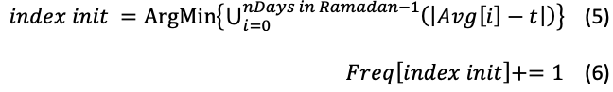
Research (Novelty)
Our Contributions / Research Novelty: iQRa’ Algorithm to Luxlier Detection of Laylat al-Qadr
The iQRa’ 1.0 algorithm is proposed to identify when the day of Laylat al-Qadr occurs in Ramadan and “1.0” is the version of the algorithm, which we have specially compiled on a few days in the month of Ramadan.
There are several mechanisms that use a combination of 2 kinds of learning techniques (semi-prediction and semi-clustering) in one unit with the following steps.
Load Dataset (1-30 Apr 2022), and calc. the temp. average value (Avg) and variance (Var)
Then, there is 2 approach to use:
First method, by finding the index of date that has the smallest Var value
Second method, by consider "nearest" and have "most high frequency", with an interval t value, taken between tmin = 15⁰ to tmax = 25⁰ Celsius
Initialization of the Frequent variable = 0.
Iterate over t, starting from tmin to tmax, to get the init index, which is the index of days in Ramadan based on Eq. 5-6.
ICGT-XIII 2023, Malang
By: Imam Cholissodin | Faculty Of Computer Science (a.k.a FILKOM), UB
Notes:
Source:
[1] https://www.techpluto.com/startup-deepai/

Slide 10
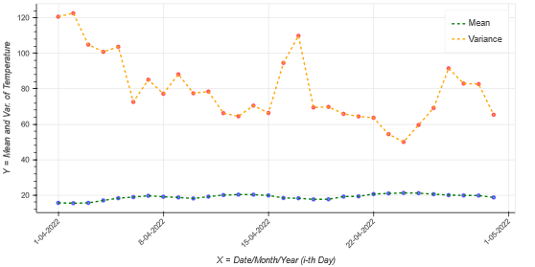
Result & Discussion (1 of 2)
Results: 2D Sequence Plot of All Mean and Variance value of Ramadan 2022, and the Minimum Variance in 24 April 2022 is equal 23 Ramadan 1443 H
The complete code of this research, please visit our github webpage at https://github.com/imamcs19/Data-Science-of-Ramadan---Deep-Mining-of-Lailatul-Qadr the open project.
This is based on a hadith narration by Imam Ahmad, the key features, i.e., the word "not cold and not hot", which implies that, in relation to this, an experiment was carried out to obtain the most minimum Diff[i] = abs(Avg[i] – t) and Var[i]value with highlight green color that is presented in Fig. besides.
ICGT-XIII 2023, Malang
By: Imam Cholissodin | Faculty Of Computer Science (a.k.a FILKOM), UB
Notes:
Source:
[1] https://www.techpluto.com/startup-deepai/

Slide 11
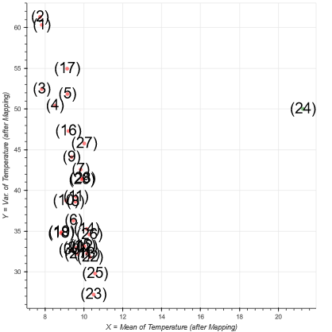
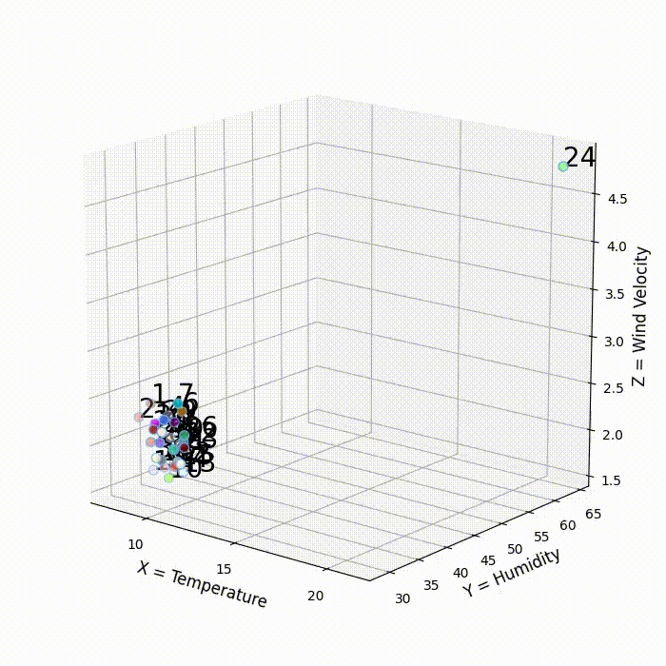
Result & Discussion (2 of 2)
Results: iQRa’ Algorithm (Training & Testing)
(a) After, mapping by scaling 2D data of Ramadan (X = Mean, Y = Variance), where 24 April 2022 is equal 23 Ramadan 1443 H
vs
(b) Visualization results from 3D mapping data of Ramadan (X = Temperature, Y = Humidity, Z = Wind Velocity) utilize weighted base index candidate LQ with t =[15;25], where 24 April 2022 is equal 23 Ramadan 1443 H
2D Visualization
3D Visualization
Fast to Get Optimum Result (Convergent)
(a)
(b)
ICGT-XIII 2023, Malang
By: Imam Cholissodin | Faculty Of Computer Science (a.k.a FILKOM), UB
Notes:
Source:
[1] https://www.techpluto.com/startup-deepai/

Slide 12
Conclusions & Future Work
Finally, based on the results of several tests, it can be concluded that the use of iQRa' algorithm is able to show and identify LQ, which is predicted to occur on 23 Ramadan 1443 H or 24 April 2022 with a t value in the interval [15:25].
Next for suggestion, It is expected that the following research will try after mapping process to use a clustering algorithm (eg Kernel K-Means or others) to create two clusters, namely group 1 with LQ class label that consist only 1 data vs Group 2 with non-LQ class label, and because the labeling process is can be set directly, so it can also consider use classification algorithm (like Support Vector Machine (SVM), Extreme Learning Machine (ELM), Deep Learning and Quantum Algorithms) and PSO / GA for optimization.
And use many data collection devices and many features involve all cities in the world with a closer collection time, in every second/ minutes/ hour so that the value of the ideal conditions of the earth can be obtained, one of which is on the LQ day when the earth's air condition is not too hot and too cold according to the references from the Prophet Muhammad SAW.
Integrated Al Engine, and High Technology to Build Smart Islamic Apps
ICGT-XIII 2023, Malang
By: Imam Cholissodin | Faculty Of Computer Science (a.k.a FILKOM), UB

Slide 13
Thanks You :D
The 13th International Conference on Green Technology (ICGT-XIII 2023)
“Strengthening the Impact of STEM world (Science, Technology, Engineering, and Mathematics) for a Sustainable Future”
#Lab. Computational Intelligence (a.k.a KC) Filkom UB
#Presenter on International Conferences ICGT-XIII 2023
Email: imamcs@ub.ac.id
Lecturer of Faculty Of Computer Science (a.k.a FILKOM) UB
Malang, October 17-18 2023

